Slide 1
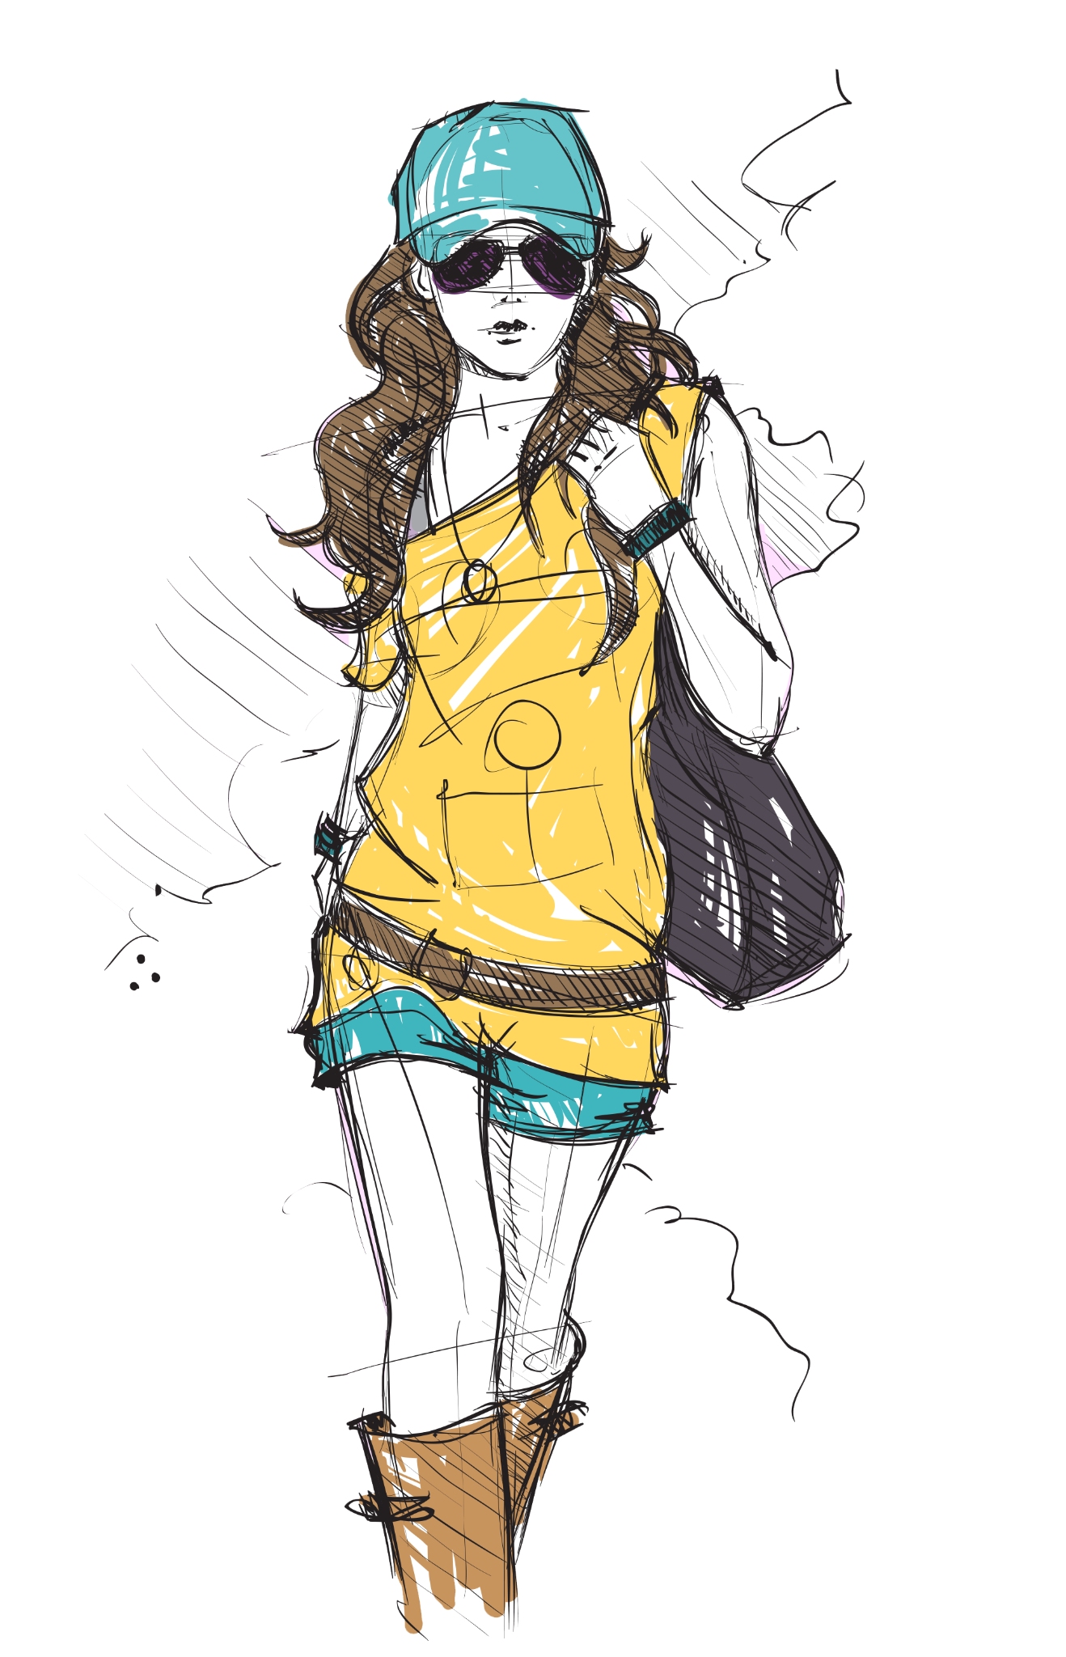
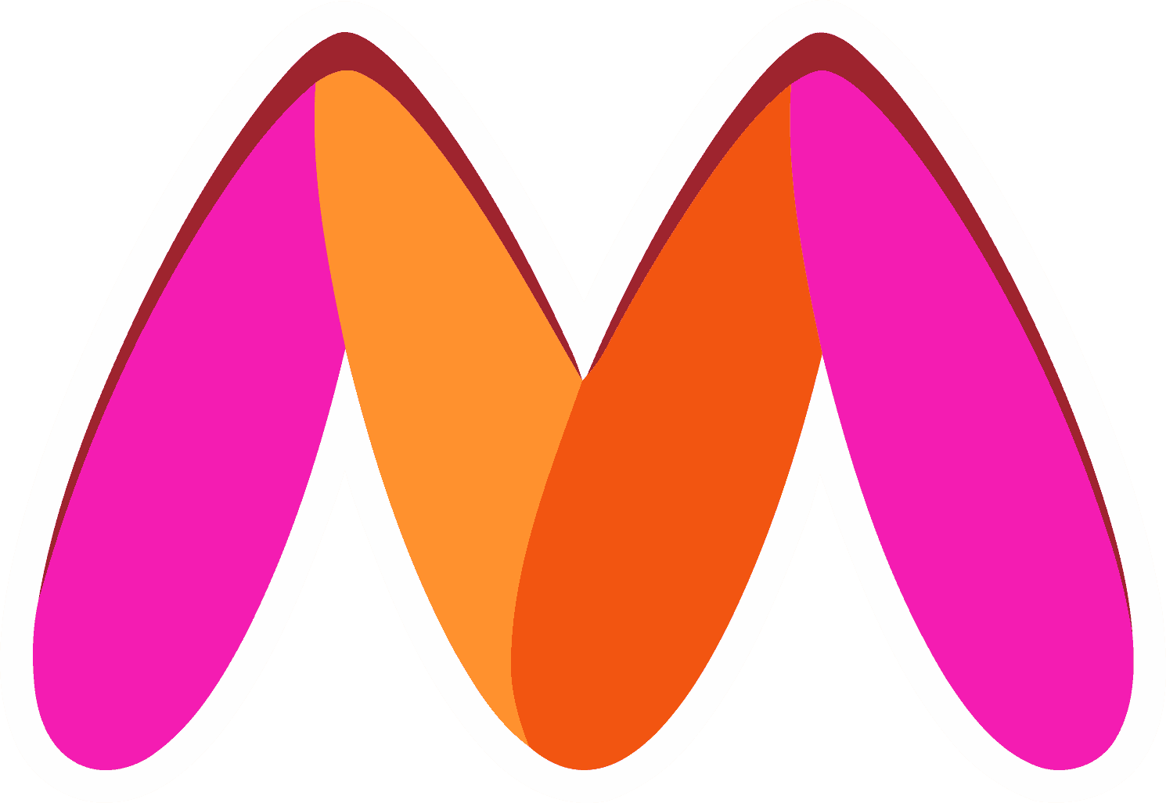
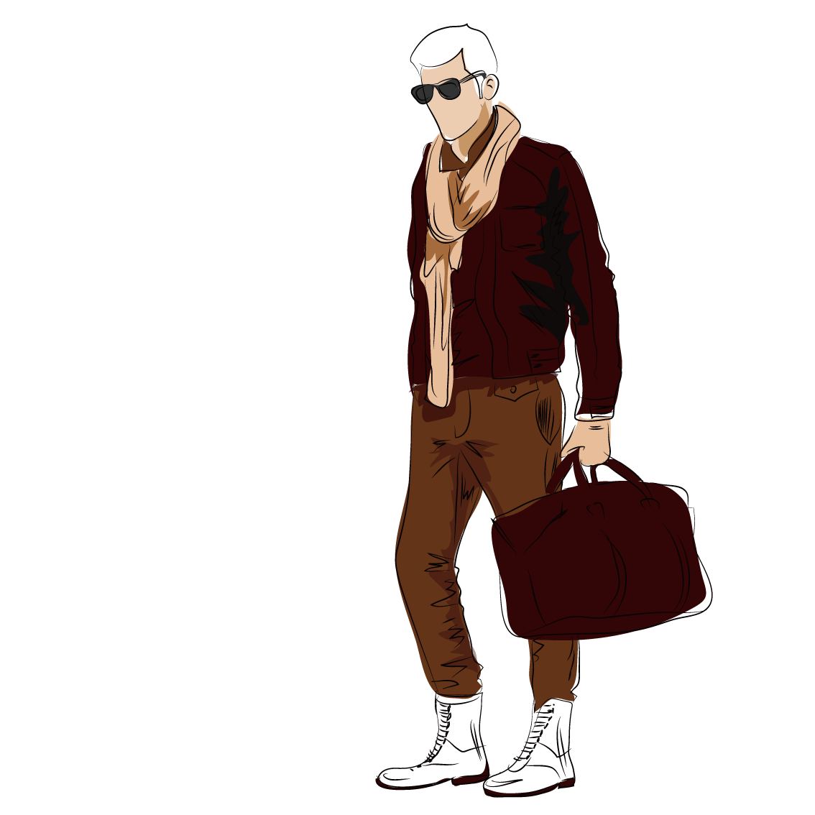
Myntra
Hackerramp
Challenge
Theme: Socialise
Frisbee
Piyush Kumar Behera
Sarthak Sahu
Sreyans Bohara
Sourav Sharma

Slide 2

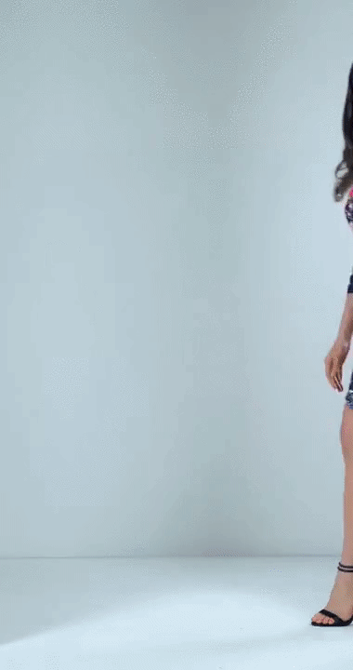
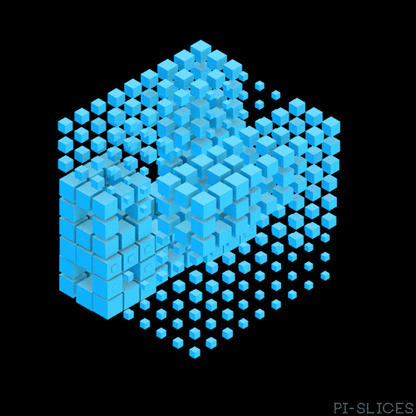
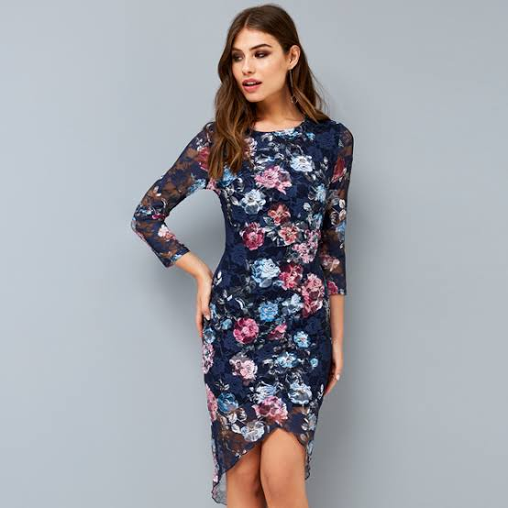
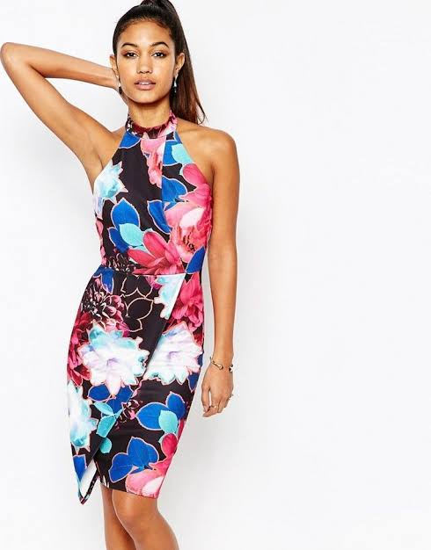
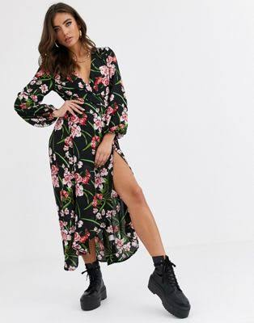
PROBLEM STATEMENT
Online shopping sites often have to manually go through each and every video and select the best outfits. This is time-consuming and labour-intensive. Our aim is to bridge this gap and make it easy for user to reach his/her dream fashion item.
We have designed a full fledged Android application through which users will be able to get the recommendations of wardrobe items based on their favourite influencers social media handles (e.g - instagram profile url).We also aim to show the best recommendation of items from the youtube’s trending videos to the user

Slide 3




Semantic Image Segmentation with DeepLabv3-Resnet:
st
nd
Segmenting Dress from the person with RCNN
Segper
Segcloth
Deeplabv3-ResNet is constructed by a Deeplabv3 model using a ResNet-50 or ResNet-101 backbone
The segmentation model is trained on PASCAL VOC dataset which contains 20 different classes
Human Keypoint Estimator is used to determine key-points/landmarks for extracting regions of clothing from the image for feature vector generation. The model is built on top of the ResNet-50 FPN (Feature Pyramid Network) backbone. Feature Pyramid Network is the concept of fusing feature maps at multiple scales to preserve information at multiple levels.The Keypoint RCNN is trained on the MS-COCO (Common Objects in Context) dataset.
OpenCV
CNN
KEY TECH
USED
PyTorch
Computer Vision
Used to segment person of interest and separating it from background using contour mask extraction.
rd
Feature Extraction
Feature Vector
Creates Embedding of cropped dress using ResNet-18 pretrained model.
Use the pretrained Resnet-18 network as feature vector generator. Intermediate layer (avgpool) is used to represent feature embeddings based on patterns, texture and color. For fashion recommendation feature vector cosine similarity is used.

Slide 4
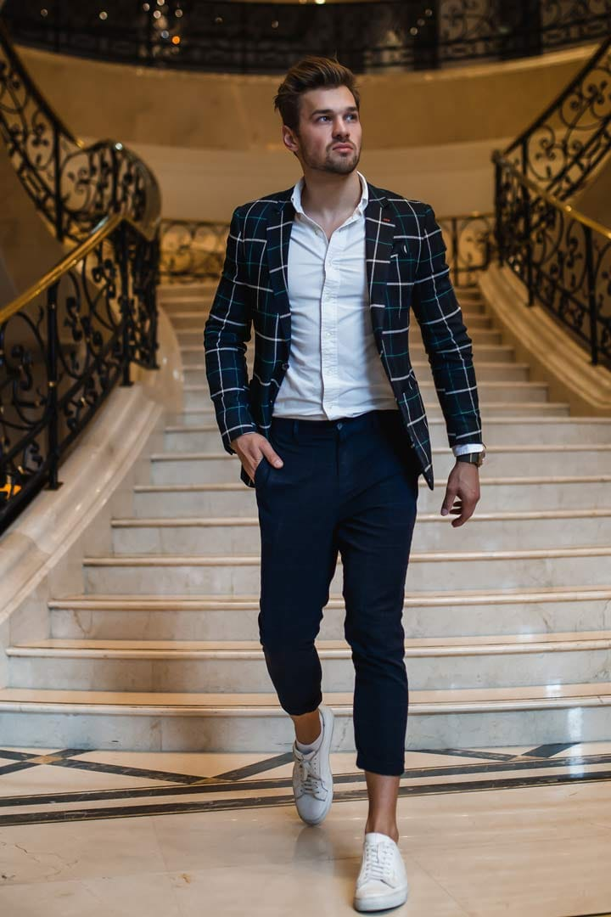
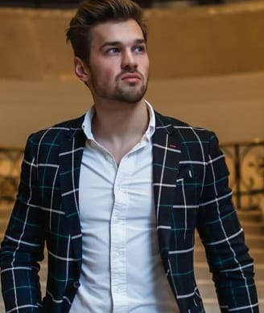
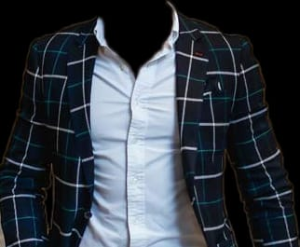
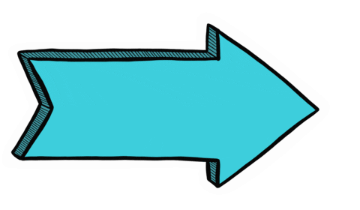
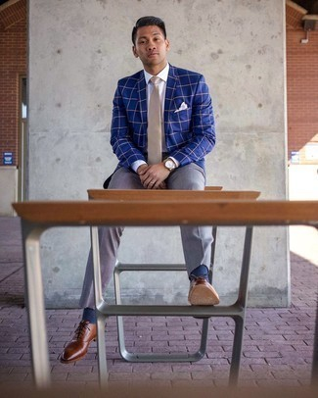
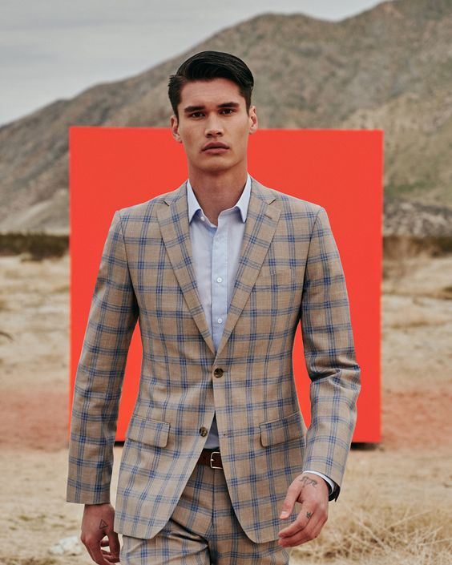
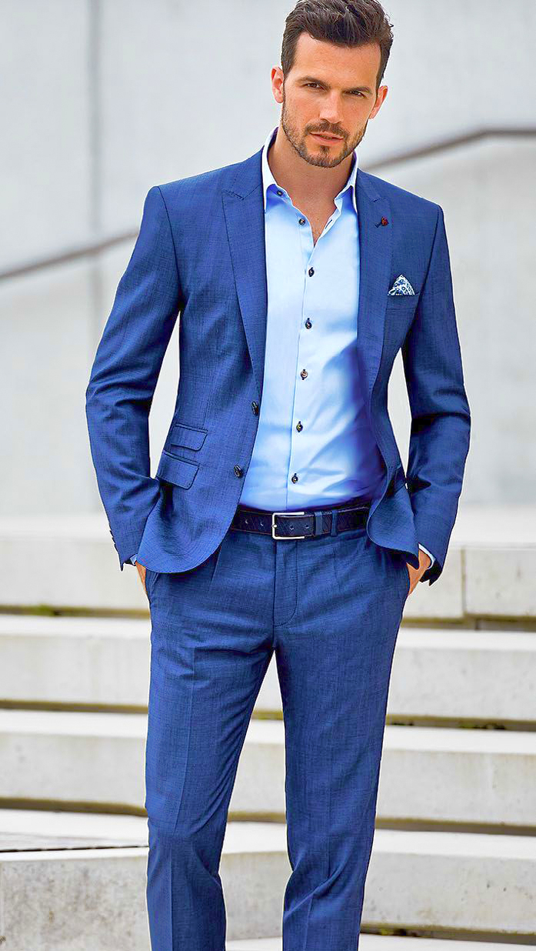
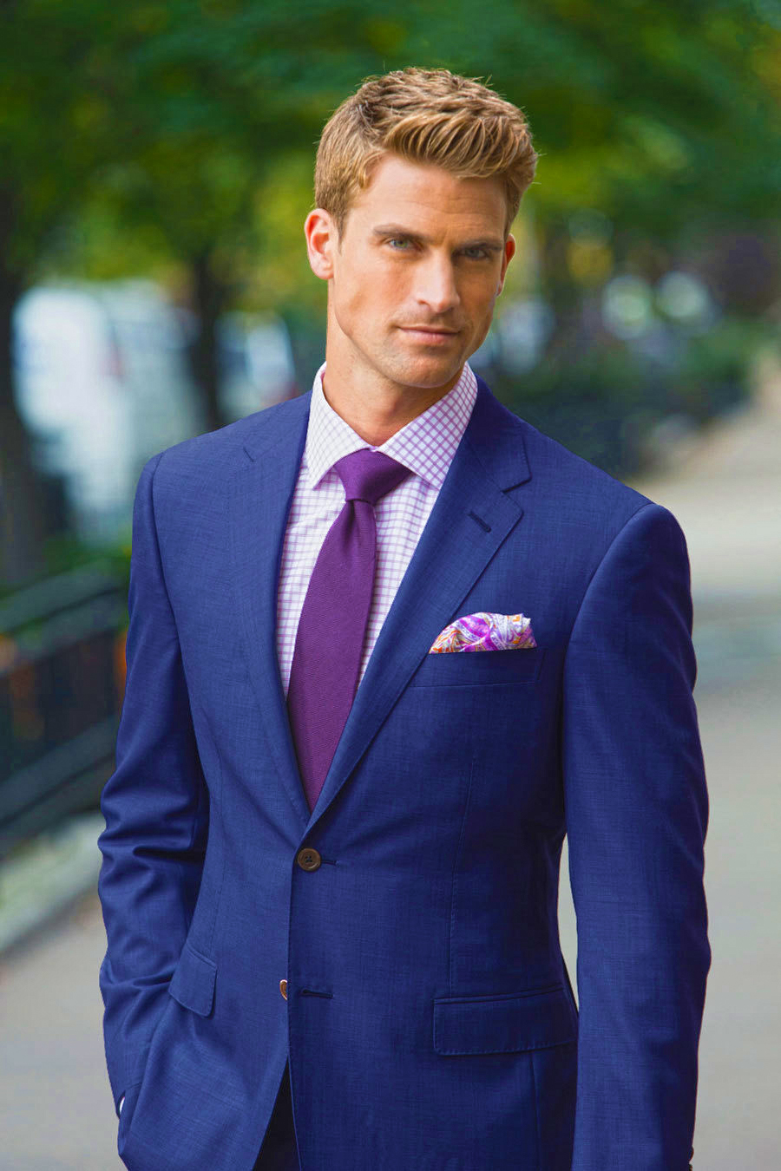
WORKING
[-1.023, 0.323, 0.234, 1.545…]
Original Image
Key point extraction
Cloth extraction
Feature Vector
Recommendation
1st
2nd
3rd
4th

Slide 5
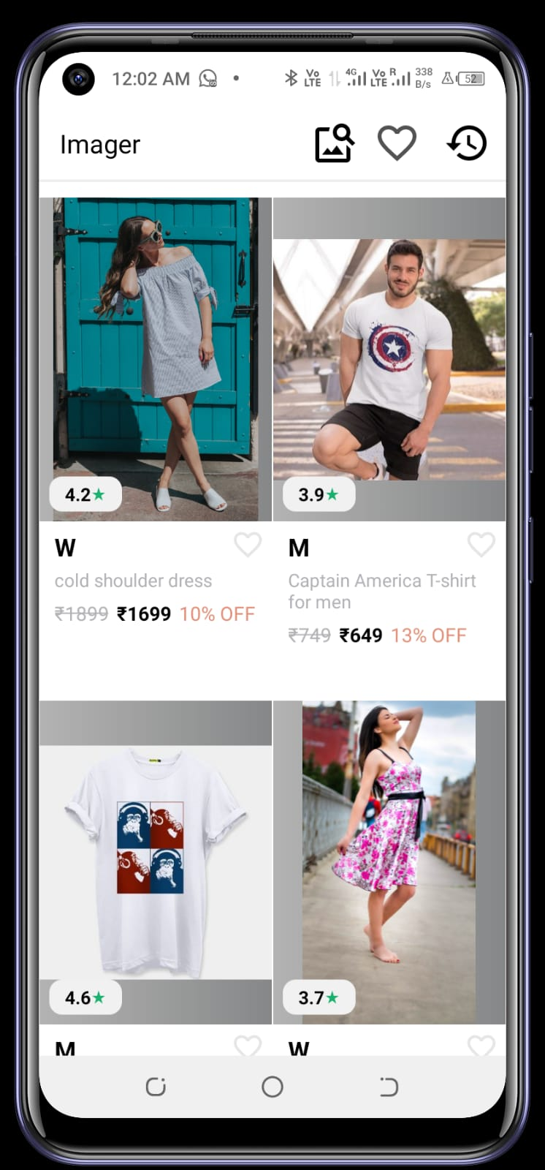
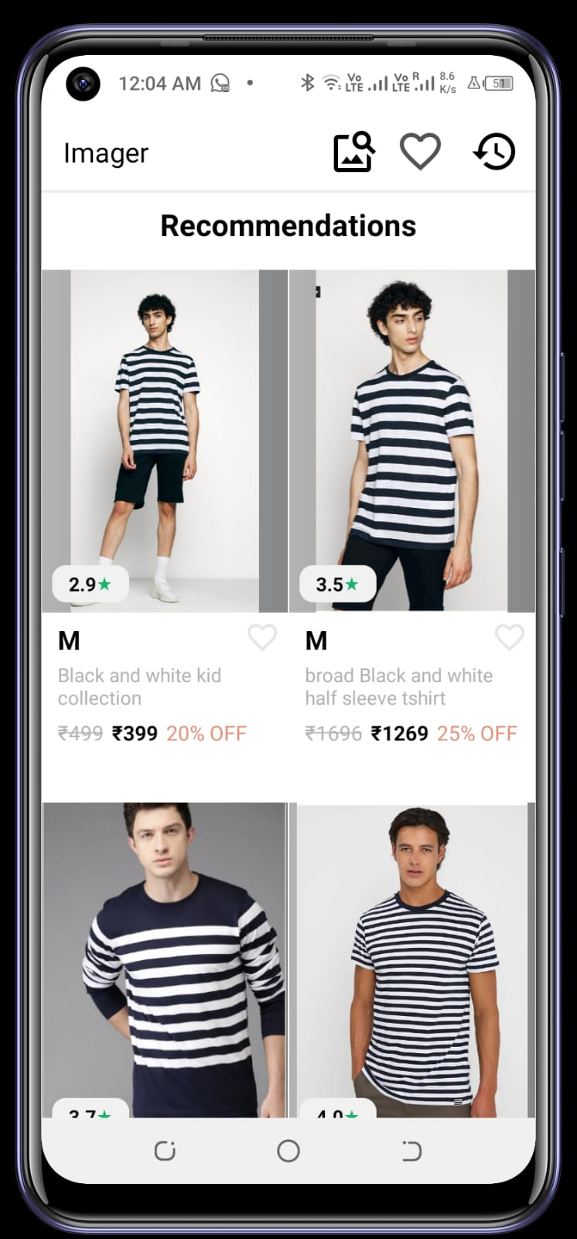
Creating the Inventory:
st
nd
Build an API to access the model through the app
Inventory
Api
With Firebase Realtime Database used as backend, we have first uploaded many images with their metadata which serve as the inventory of our project.
We used flask to make an API to access out model and deployed it locally to access the model in our android app. Image selected from storage is passed as image url to the api call which is then processed by the model, and the desired result is returned by the model which is then displayed in the app
Database
Deployment
Android
App
MVVM
UI design
Java,Kotlin
rd
Initial
Imager app
to
‘Imager’ app to give instant recommendations with use of image uploaded by user
Imager app with myntra-like ui design which will show instant recommendations to the user by running the deep learning model in an android app using MVVM architecture.
Final

